Slide 1
3D Scene Models from Images
Mengqian Liu,Tianjiu Yin
Department of CCSP/CS, UCSB

Slide 2
OUTLINE
Background
Theory
Application
Optimization
Future Work
Conclusions

Slide 3
Background
Single View Reconstruction
from recognizable geometric
Lines
Planes
Spheres
computing their spatial layout given only one view

Slide 4

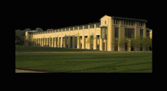
Background
Related Work
Automatic Photo Pop-up, Derek Hoiem
Make3D, Ashutosh Saxena

Slide 5
Theory
Edge detection
Structure recognition
Camera Calibration
Ratio Calculation
3D construction
Texture mapping

Slide 6
1. Edge detection
Canny
Edge Detector
Unable to locate edge of object
Problems?

Slide 7
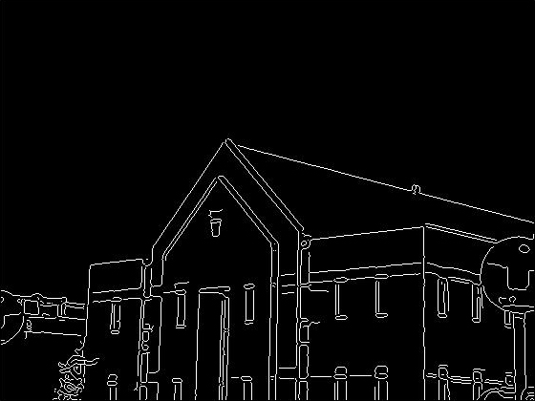
Edge detection
Canny
Edge Detector
Unable to locate edge of object

Slide 8
1 Edge detection
Canny
Edge Detector
Unable to locate edge of object
Fill Background + Line Detection
Flood Fill
Opencv Houghlines

Slide 9


Slide 10
2 Structure recognition
Problems

Slide 11
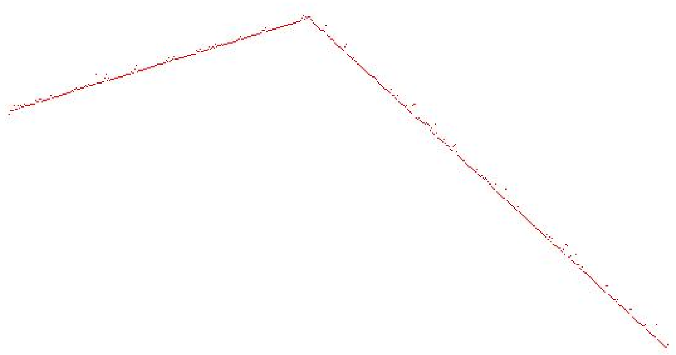

Slide 13
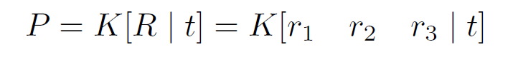
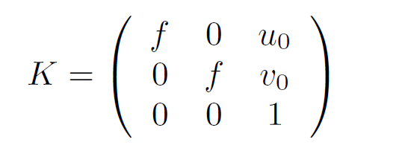
3 Camera Calibration
Classic Method
P: Project Matrix
K: Camera Calibration

Slide 14
3 Camera Calibration
Better Solution
Based on recognizable geometric

Slide 15
3 Camera Calibration

Slide 17
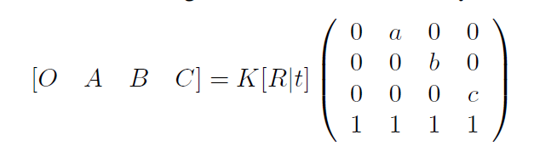
4 Ratio Calculation
Related Work
Peng, Kun, et al. "Single view metrology along orthogonal directions." Pattern Recognition (ICPR), 2010 20th International Conference on. IEEE, 2010.

Slide 18
4 Ratio Calculation
Limitations
Complicated:
Solve quadratic equations with three variables
Approximations twice

Slide 19
4 Ratio Calculation
Better Solution
Based on recognizable geometric

Slide 21
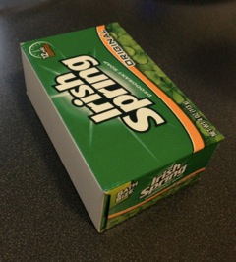
Results
Perspective point:
1131.0586255095657
1731.3350956486906
Focus Length
3399.7369053108278
Ratio
1.5783772634070246,
1.5776488261808865
2.490125036884692

Slide 22
Results
Measurements:
Length: 9.8 cm
Width: 6.2 cm
Height: 3.8 cm
# | Real | Result | Relative Error
Length/Width | 1.58 | 1.578 | 0.1 %
Width/Height | 1.63 | 1.577 | 3.2 %
Length/Height | 2.57 | 2.490 | 3.1 %

Slide 23
Results
# | Real | Result | Relative Error
Length/Width | 1.58 | 1.578 | 0.1 %
Width/Height | 1.63 | 1.577 | 3.2 %
Length/Height | 2.57 | 2.490 | 3.1 %
Inaccuracy Analysis
Small value of height

Slide 24
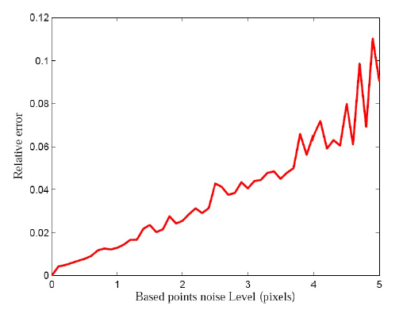
Comparison
# | Relative Error
Length/Width | 0.1 %
Width/Height | 3.2 %
Length/Height | 3.1 %
Peng, Kun, et al. "Single view metrology along orthogonal directions." Pattern Recognition (ICPR), 2010 20th International Conference on. IEEE, 2010.
Our results

Slide 25
5 3D construction
OPENGL ES 2.0
Predefined mesh as a cuboid
Multiply the length of edge by scalar that is got from the previous calculation

Slide 26

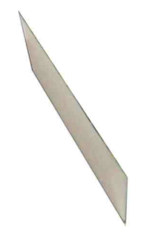
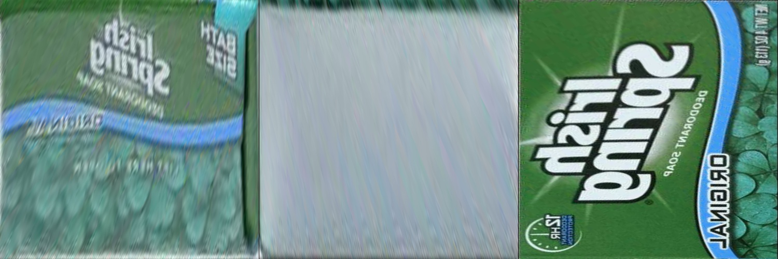
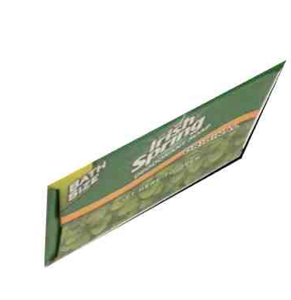
6 Texture mapping
Imgproc.warpPerspective

Slide 27
Application

Slide 28
Application
Input Image
Camera (Adjust Threshold) / Gallery
Geometrical Calculation
Get the ratio of the edges & intrinsic matrix
3D model Display
Build 3D model & Texture mapping
Edge Recognition
Automatically / Manually

Slide 29
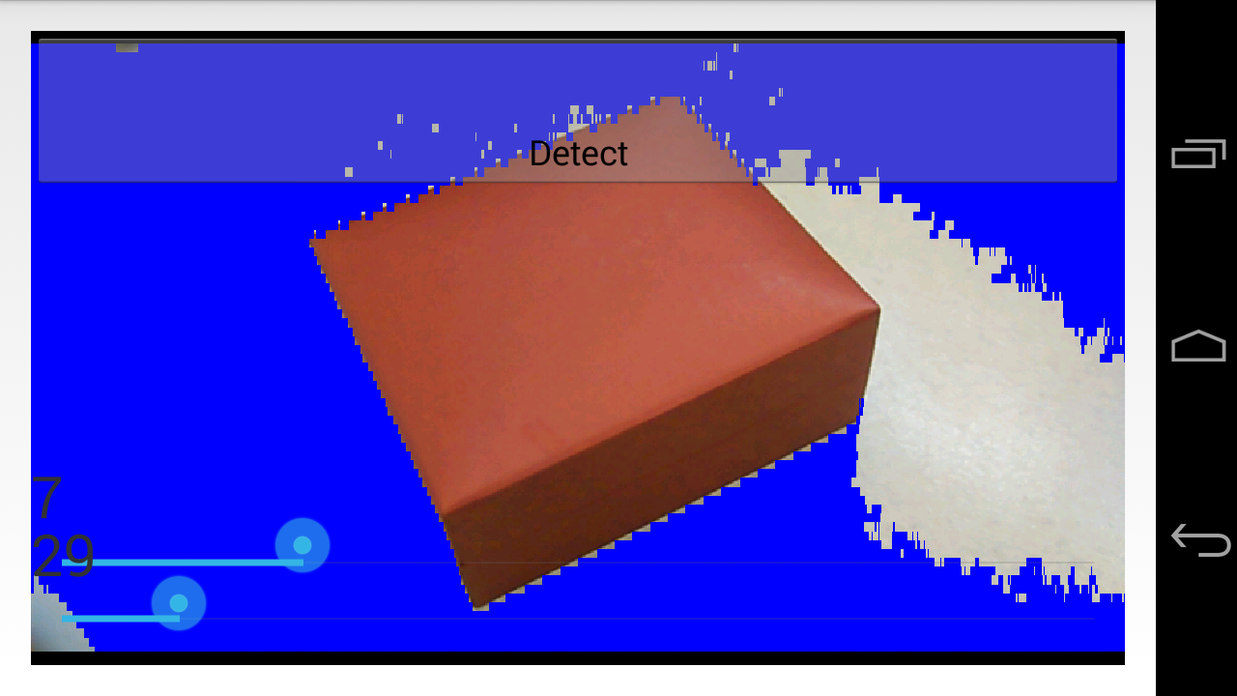
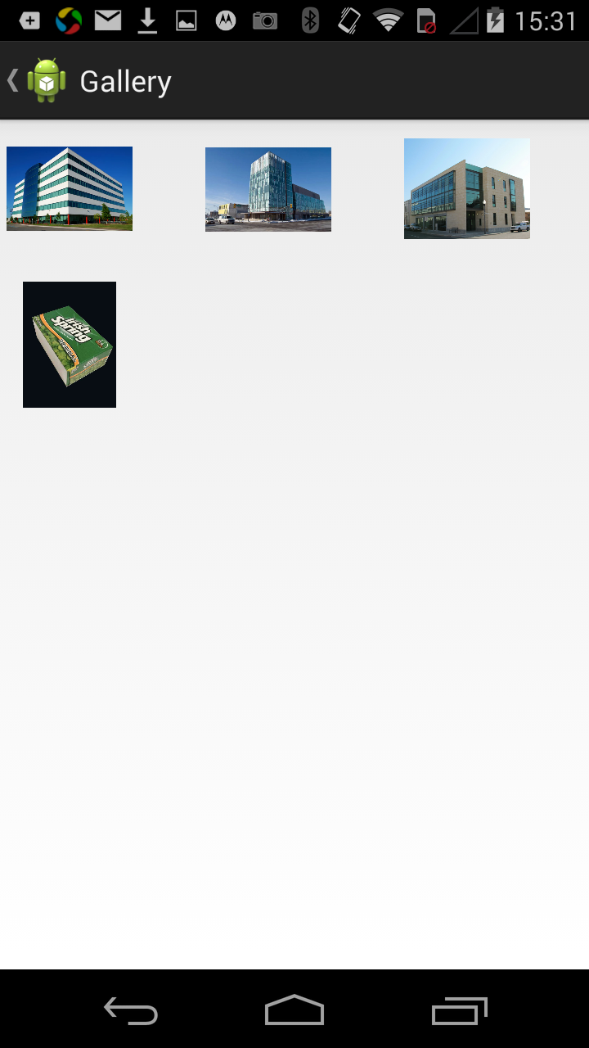
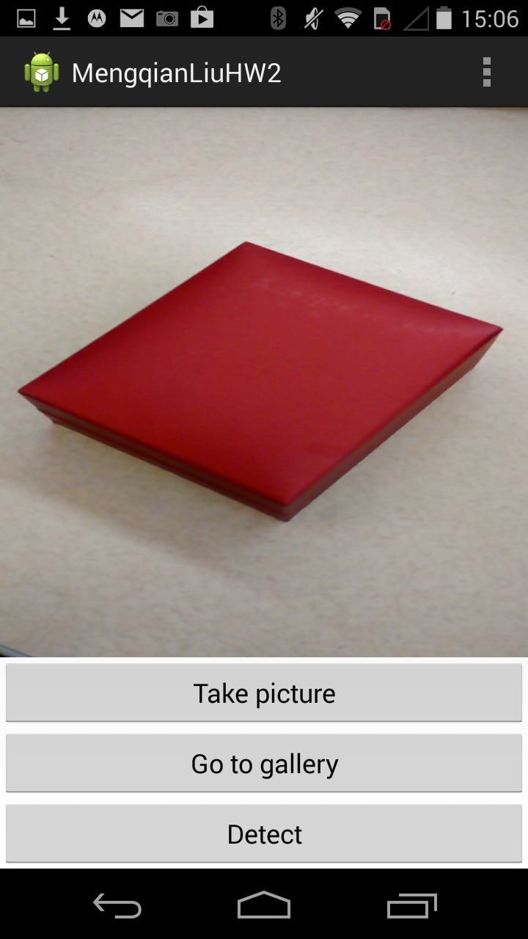
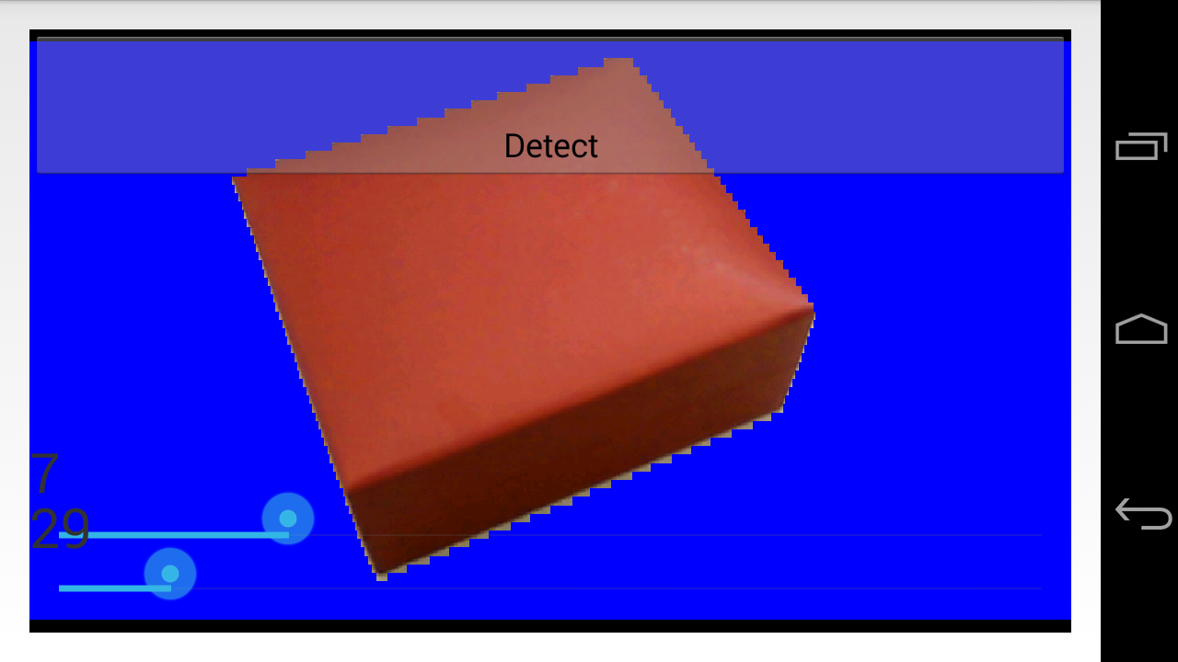
Application
Input Image
Camera (Adjust Threshold) / Gallery
Geometrical Calculation
Get the ratio of the edges & intrinsic matrix
3D model Display
Build 3D model & Texture mapping
Edge Recognition
Automatically / Manually

Slide 30
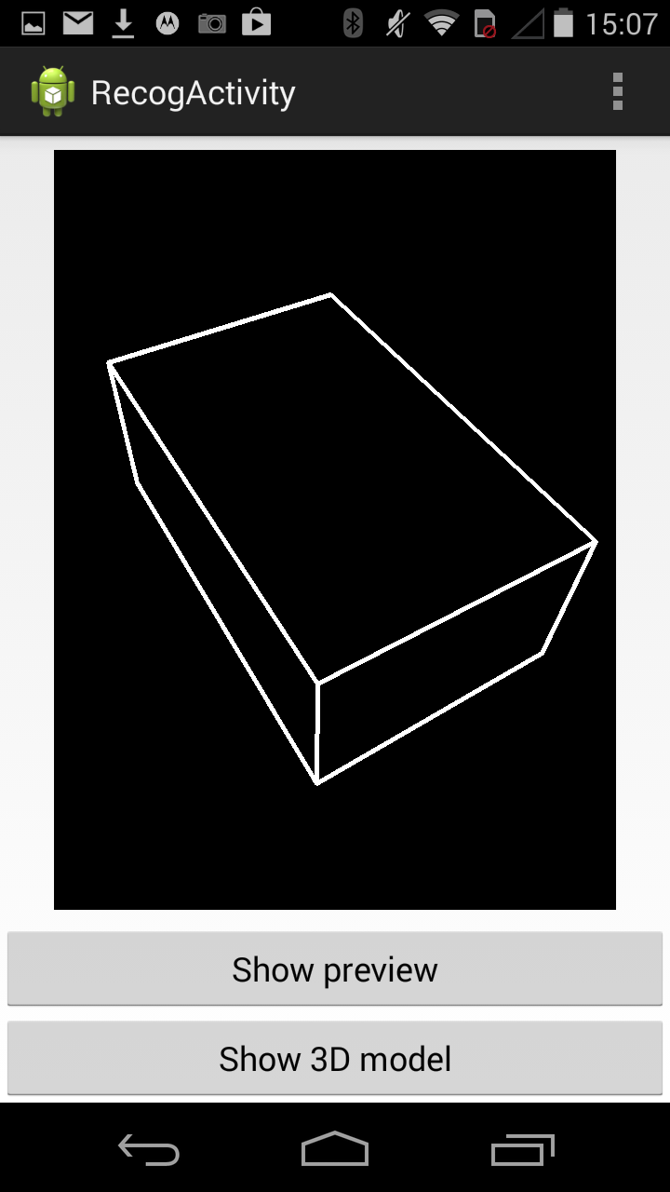
Application
Input Image
Camera (Adjust Threshold) / Gallery
Geometrical Calculation
Get the ratio of the edges & intrinsic matrix
3D model Display
Build 3D model & Texture mapping
Edge Recognition
Automatically / Manually

Slide 31
Application
Input Image
Camera (Adjust Threshold) / Gallery
Geometrical Calculation
Get the ratio of the edges & intrinsic matrix
3D model Display
Build 3D model & Texture mapping
Edge Recognition
Automatically / Manually
Notes:
加表格

Slide 32
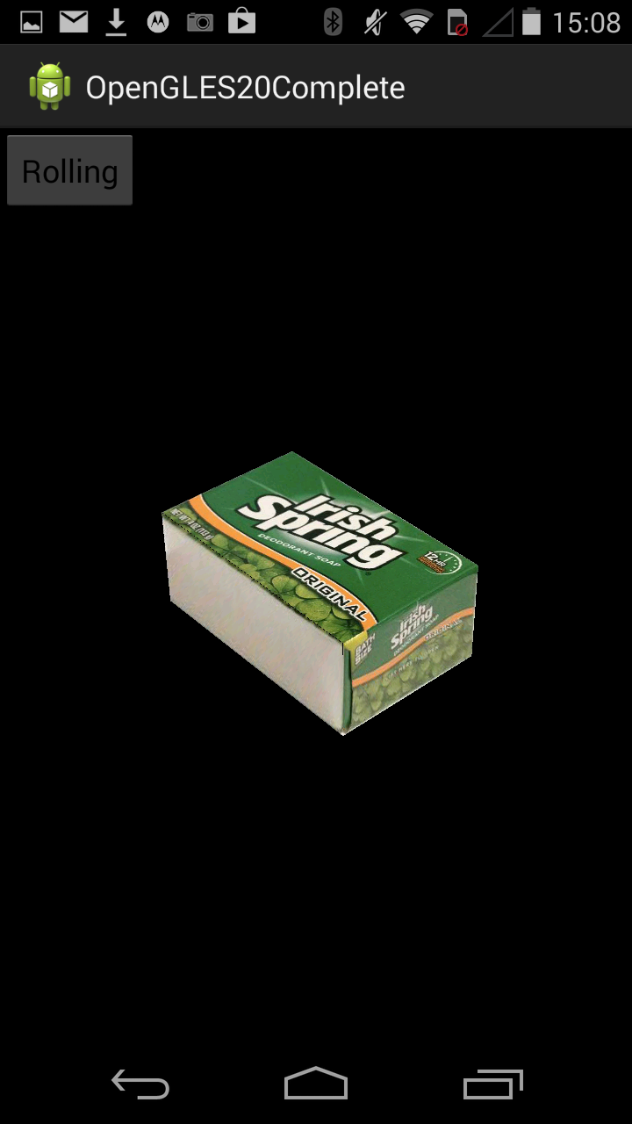
Application
Input Image
Camera (Adjust Threshold) / Gallery
Geometrical Calculation
Get the ratio of the edges & intrinsic matrix
3D model Display
Build 3D model & Texture mapping
Edge Recognition
Automatically / Manually
Notes:
Use the ratio get from the last step to build the cuboid model and do the relative texture mapping.

Slide 33
Demo

Slide 34
Optimization
Flood Fill Algorithm
Memory
Variable accuracy

Slide 35
Future Work
One Cuboid → Multiple
Strong contrast Background→
More Robust
More Object models

Slide 36
Conclusion
Challenging without depth
Utilize geometric primitive
Balance between accuracy and speed
Integrate user interaction

Slide 37
Thank you!

